Slide 1

Buy / Keep / Sell recommendation BOT for Bitcoin

Slide 2

CONTENT
Selected topic
Reason why they selected their topic
Description of their source of data
Questions they hope to answer with the data
Description of the data exploration phase of the project
Description of the analysis phase of the project
Technologies, languages, tools, and algorithms used throughout the project

Slide 3
Selected topic
Recommendation to buy, sell or hold Bitcoins
Using Machine Learning
Reason why they selected their topic
The cryptocurrency market now worth more than $2 trillion has attracted the attention of investors. It is not too late to enter this world. It has been decided to work with the BTC cryptocurrency as it has a unique advantage to the rest being the first cryptocurrency to appear on the market and has managed to create a global community and give rise to a whole new industry of millions of enthusiasts who create, invest, trade and use Bitcoin and other cryptocurrencies in their daily lives. BTC remains at the top of this market after more than a decade of existence. Even after Bitcoin has lost its undisputed dominance, it remains the largest cryptocurrency, with a market capitalization that surpassed the $1 trillion mark in 2021, after Bitcoin's price reached an all-time high of $64,863.10 on April 14, 2021.
When is the best time to buy or sell? Should I hold on to my portfolio? This is every investor's dilemma and with the application of machine learning models, we are likely to get the information we need to know the future of cryptocurrencies.

Slide 4
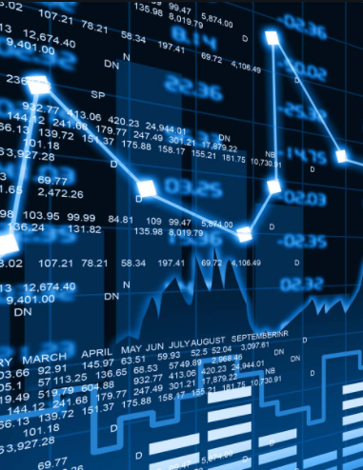
Description of their source of data
Daily prices with 30-minute intervals and a range of 1 year of data. The source of information would be Refinitiv Eikon with Binance data.
Questions they hope to answer with the data
When is the best time to buy or sell? Or should I hold on to my portfolio?
Description of the data exploration phase of the project
The first step is to extract the Bitcoin historical data, this data will be downloaded in a csv file from Refinitiv Eikon.
Using Pandas we will convert the file into a DataFrame which will be used to analyze the data.
We will graph the data in the DataFrame to visualize the movements of Bitcoin over the last year to identify trends.

Slide 5
Description of the analysis phase of the project
We will use a time series model to predict cryptocurrency prices and thus be able to indicate whether it is a good time to buy, sell or hold our position in Bitcoin. It will not tell us the future, but it might tell us the general trend and direction to expect the prices to move.
Technologies, languages, tools, and algorithms used throughout the project.
For data processing, it is planned to work with:
Python
Machine Learning models
Data Base - MongoDB
Tableau

